Slide 1
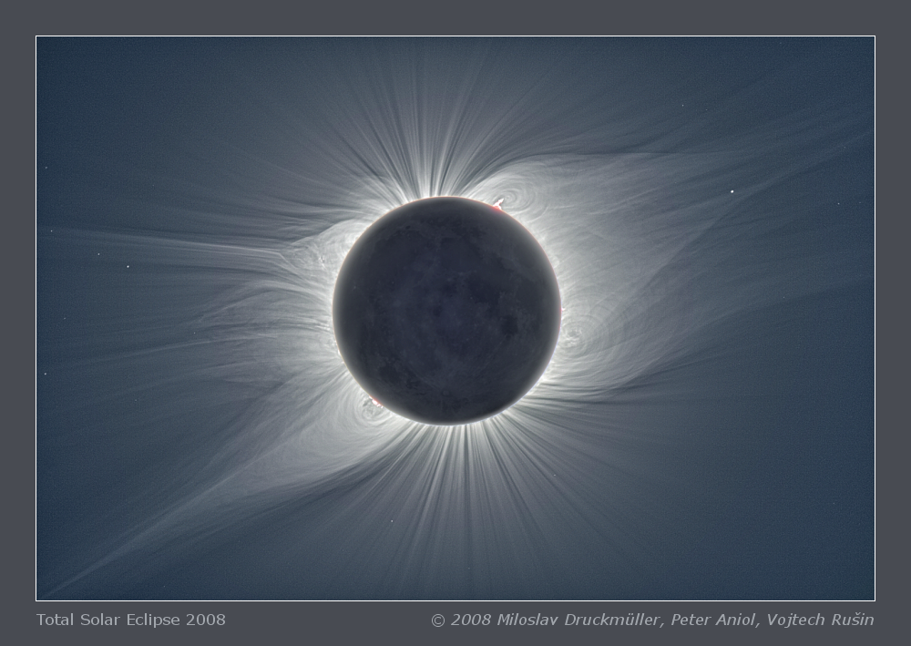
The Lomb-Scargle Algorithm
Alex Matheson & Austin Nhung

Slide 2
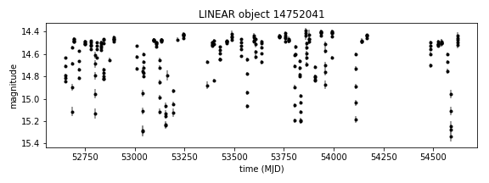
What is it?
Lomb-Scargle methods are a way to analyse signals with inconsistent time series
Generates data on underlying periodicity
FIG 1. Example data showing light intensity of a star (LINEAR catalogue number 14752041) over time.

Slide 3
Where is it used?
Many applications where it is not possible to constantly record, or there are gaps in records of past events.
Sees heavy use in astronomy – weather, day/night cycle, seasonality all can prevent consistent data capture
Important in climate science – used to deal with gaps in sediment and ice cores

Slide 4
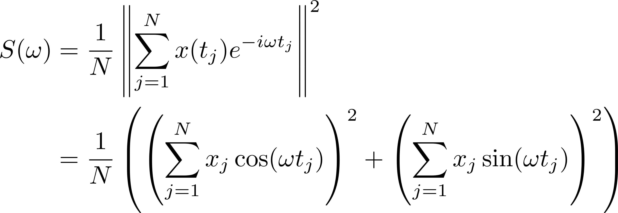
What is a Periodogram?
An estimate of the power spectral density, characterizing the signal in terms of the power of each frequency
The classical periodogram is the square of the Fourier transform, and can be computed with the DFT

Slide 5
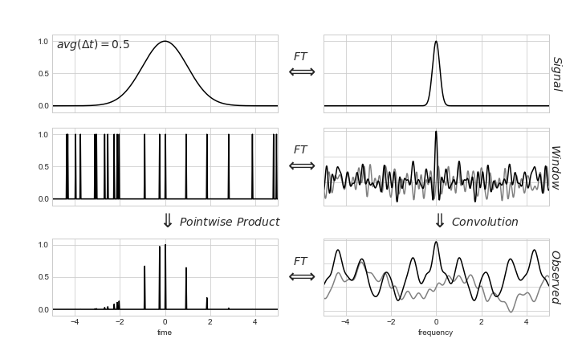
Why not FFT?
For the FFT, an uneven delta-comb sampling window is asymmetric, and has a noisy Fourier inverse. This gives a noisy result.
Spectral leakage from high frequencies to low frequencies is also a common problem
Source: Vanderplas 2017

Slide 6
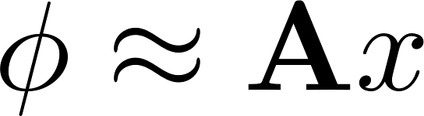
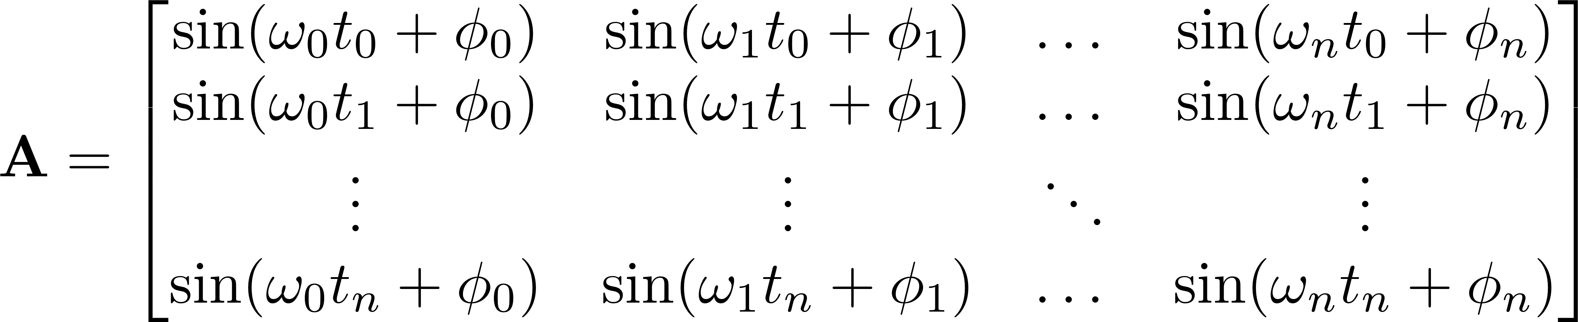
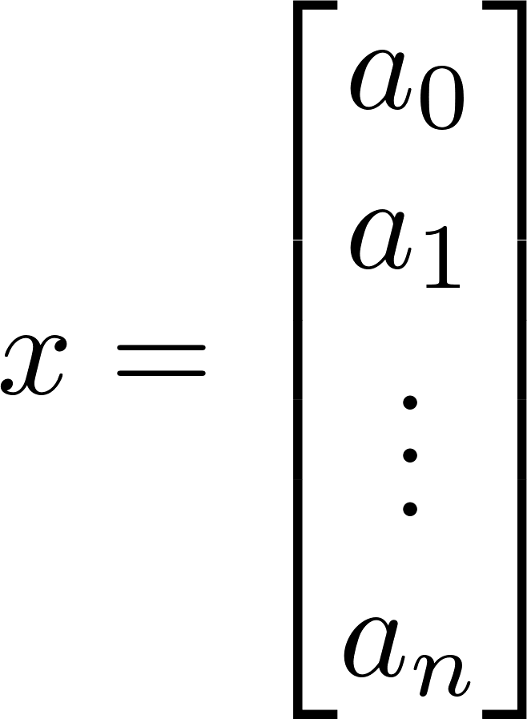
Mathematics
Relies on Fourier series. Instead of Fourier transforming the data straight away, it determines the frequencies of interest, then fits coefficients to the frequencies using a least-squares method.

Slide 7
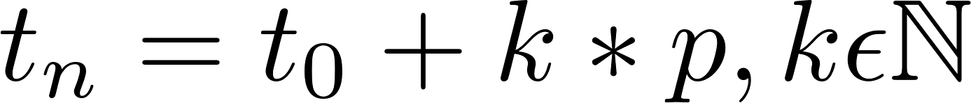
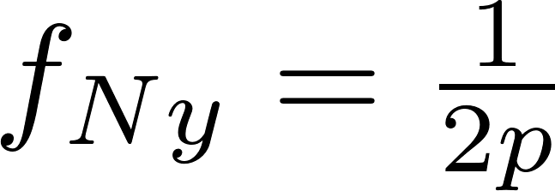
Choosing Frequencies
Different frequencies may be selected for the A matrix. A good selection of frequencies can improve results.
The minimum frequency is often set as the inverse of the test duration
The maximum frequency is often based on the Nyquist frequency.
The Nyquist frequency doesn’t apply for non-uniform data. We can use an approximation for a benchmark. (We can actually find patterns below Nyquist)
The frequency is then oversampled for safety
Non-uniform Nyquist model:

Slide 8
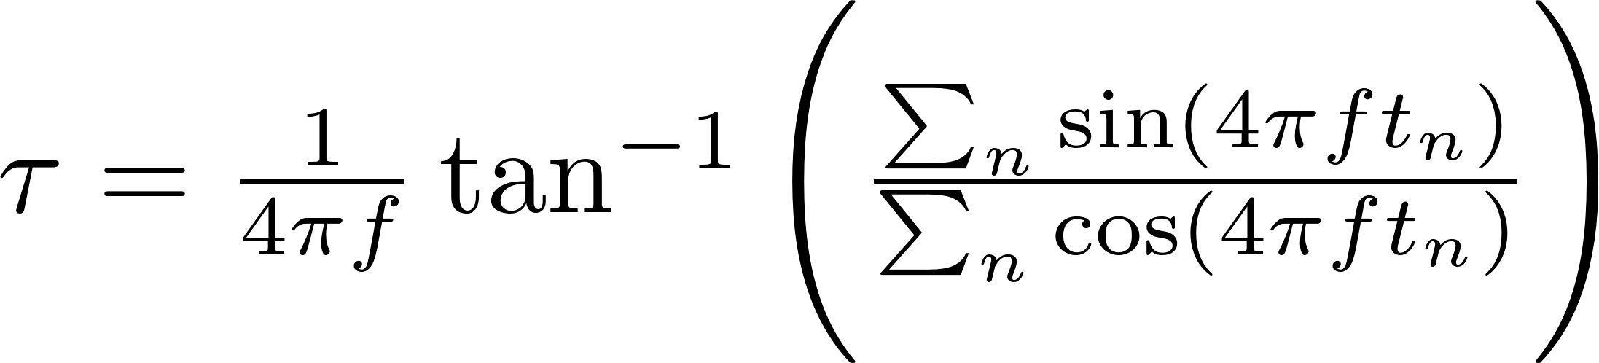
Phase
Each frequency should be fit to both amplitude and phase. We will fit the phase first, then fit the amplitudes.
The phase should shift the proposal wave to have a maximum at the maximum of the given data
The phase τ is calculated for each frequency f by:

Slide 9
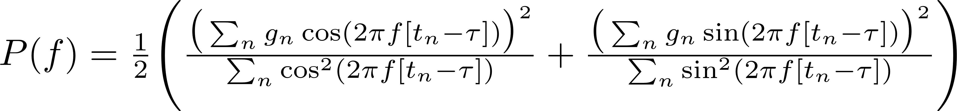
Power
The least-squares method result is the following equation:

Slide 10
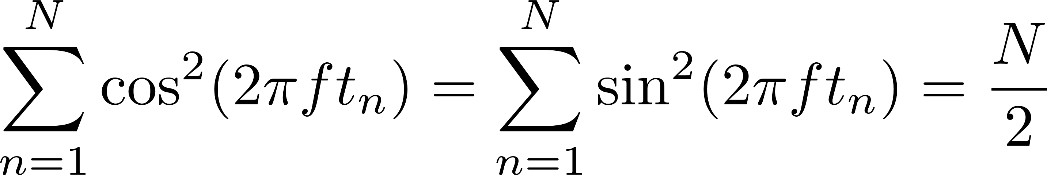
Error
The previous equations rely on some approximations, namely:
This error is χ² distributed, meaning we can calculate the likelihood that a peak is due to periodic behavior.

Slide 11
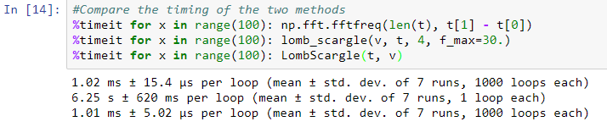
Lomb-Scargle vs. FFT
The Lomb-Scargle algorithm is much slower than DFT, but faster than FFT, operating at order O(n) instead of O(n²) and O(nlog2(n)) respectively
When you can use both Lomb-Scargle and FFT, FFT is actually faster. This is because Lomb-Scargle relies on oversampling.
FFT
Our algorithm
astropy

Slide 12
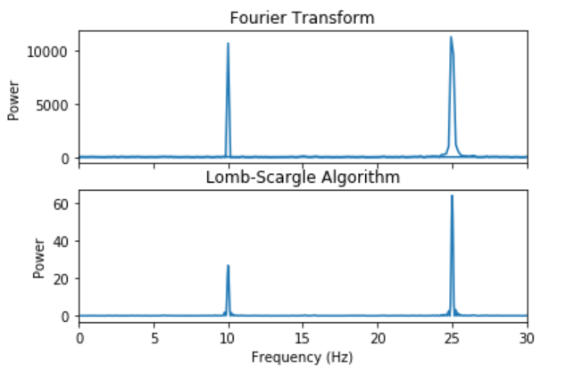
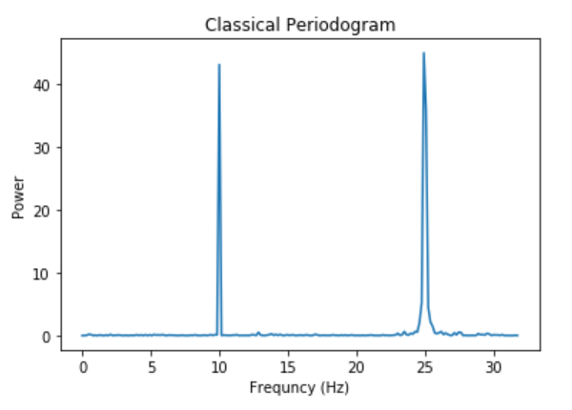
Example: Mathematical
Simple example signal $$\frac{1}{2} \sin(2 \pi 10 t) + \frac{4}{5} \sin(2 \pi 25 t)$$

Slide 13
Astropy
Astropy has developed a simple class for handling Lomb-Scargle peridograms
Pros | Cons
Object-oriented | Automatically sets the A matrix
Simple commands | Manual selection of A values far less simple
Includes 6 different algorithm implementations | Can’t handle error in time measurements
Can handle error in signal amplitude
Built-in tests for units, significance

Slide 14
Astropy Example
Recall our initial example. Astropy can analyse this data set using its class notation

Slide 15
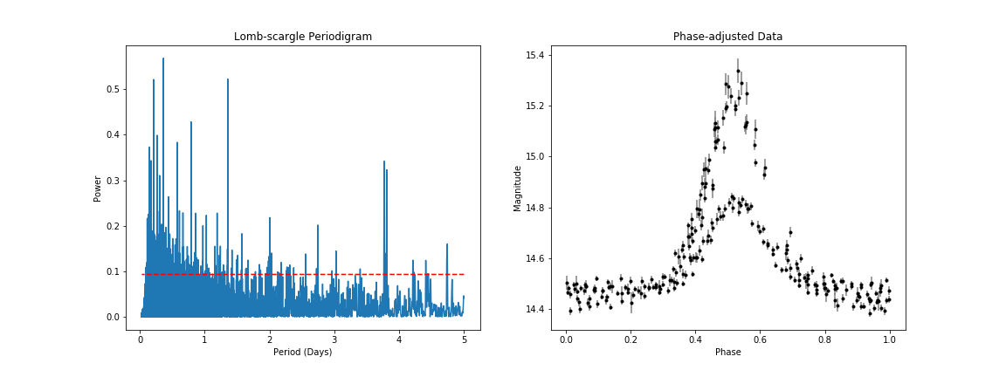
Astropy Example
Once we plot the periodogram, we can see that there are many significant peaks. We can obtain a periodic signal using the most significant peak (p=1.9e-40)

Slide 16
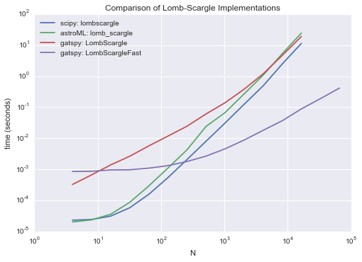
Comparison - Summary
Between…
Source: J. Vanderplas 2015.

Slide 17
Conclusion
The Lomb-Scargle periodogram can find periodic behaviour like the FFT, but is useful in different situations:
It is mainly used when data points are not evenly spaced
It may be used to find periodic data above the Nyquist frequency
Unlike the FFT, the Lomb-Scargle method introduces error that may be tracked
Successful use of the method requires selecting a good frequency grid
Python libraries such as scipy and astropy provide quick and easy to use tools to apply the method to data

